Slide 1

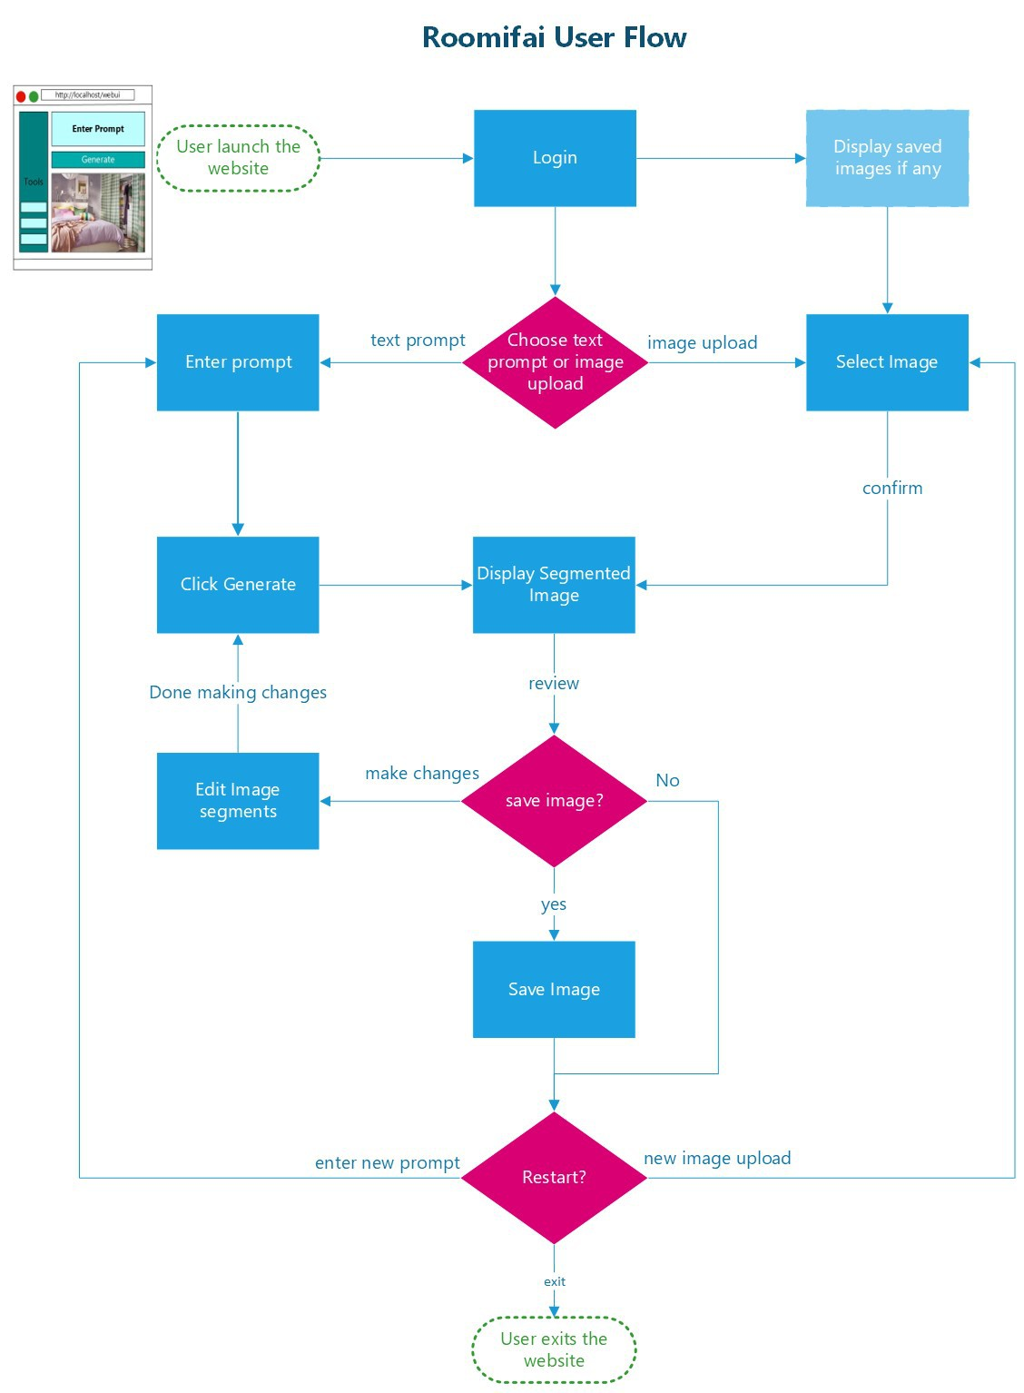

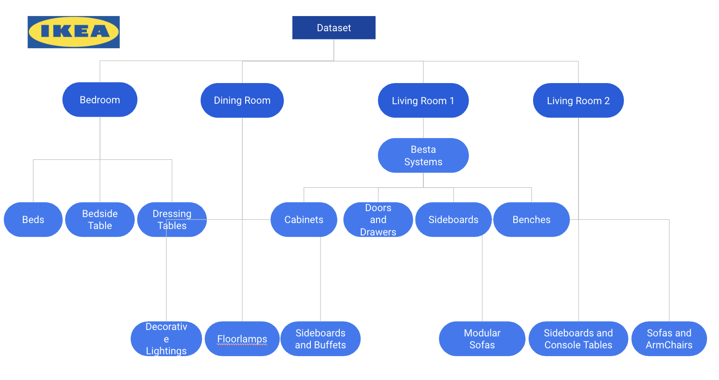
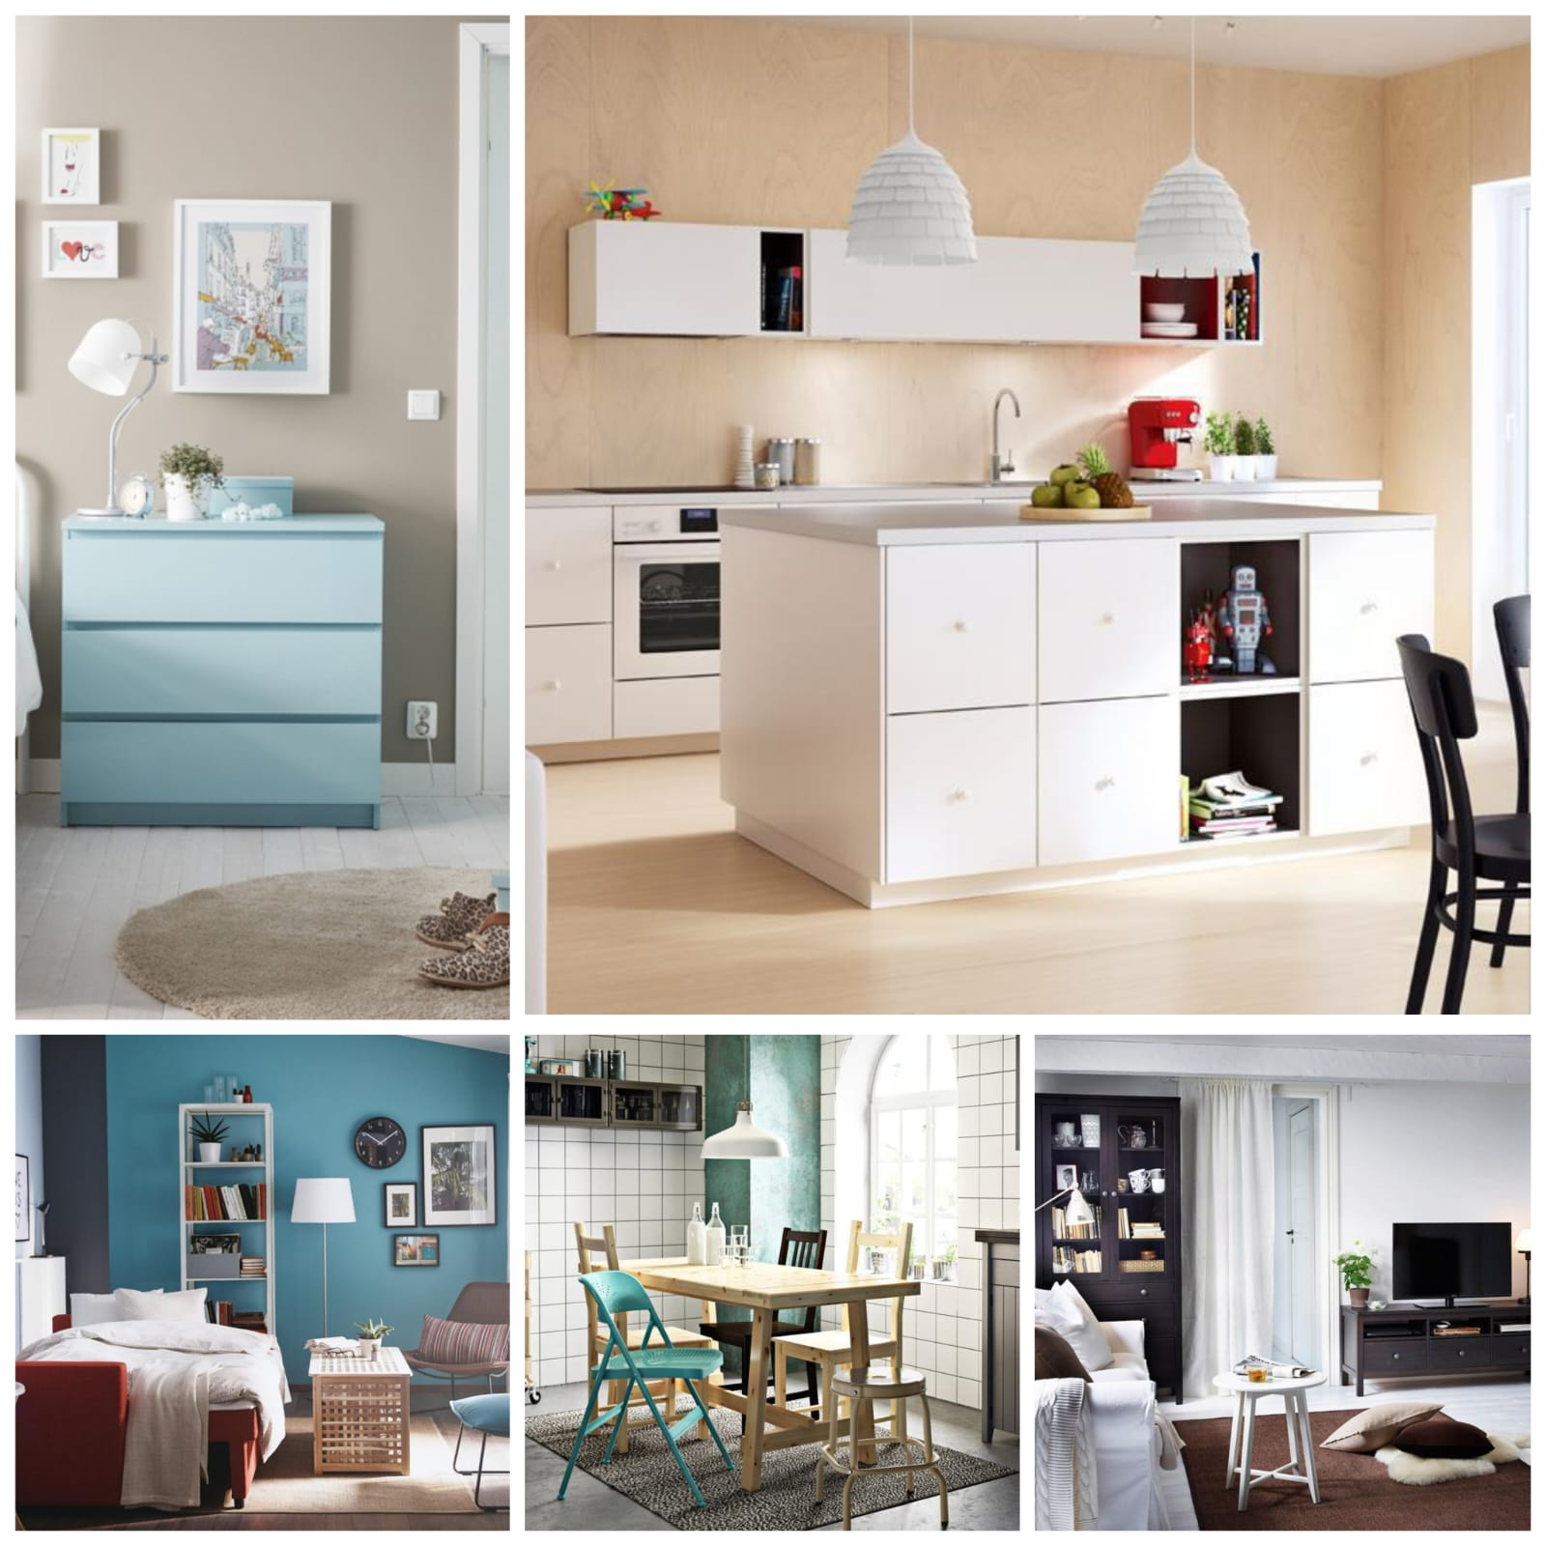
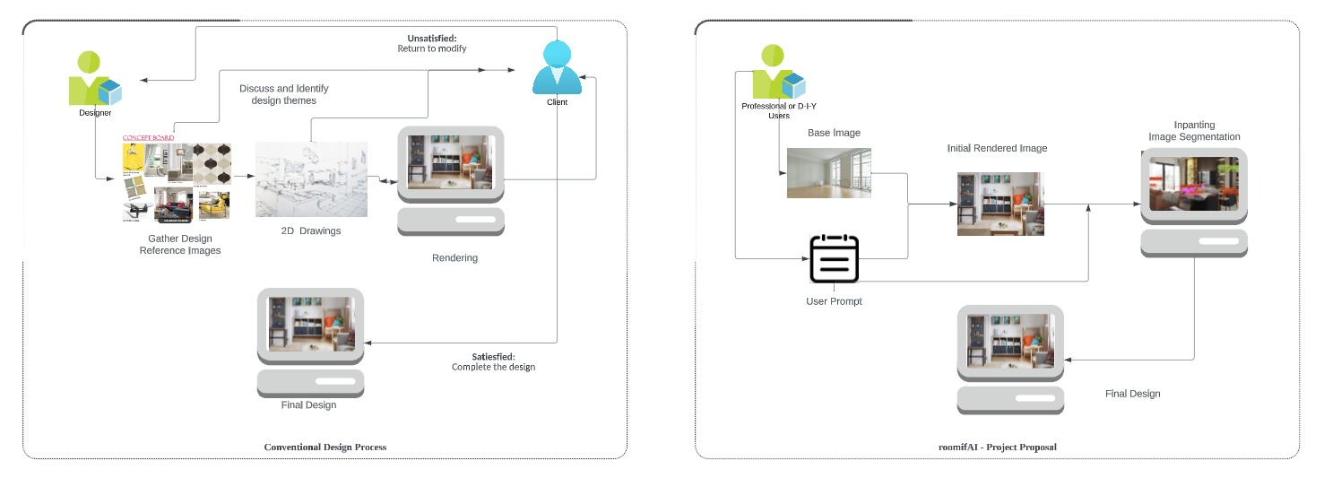
Group 5
Project Proposal
roomifAI
Practice Module Project Work
Graduate Certificate in Pattern Recognition Systems
September 29, 2023

Slide 2
roomifAI
Project Background/Objective/Aim
provide interior design visualizations
quick and easy method
Notes:
The tool provides potential value for interior designers, real estate agents or developers aiming to enhance visual representations for clients by presenting preliminary concepts/prototypes of any particular room design, whether to better market a property, or to present design ideas for clients wishing to refurbish their homes. Additionally, it could cater to initial requirements of various professionals like interior designers, bathroom designers and fitters, event organizers, kitchen designers, property photographers, and other related domains. The tool provides a foundational layout along with potential designs, finishes, and furnishings to enhance visual appeal.
For the project purpose, the tool will be used for bedrooms, living room, kitchen and bathroom, with potential development for other types of rooms.

Slide 3
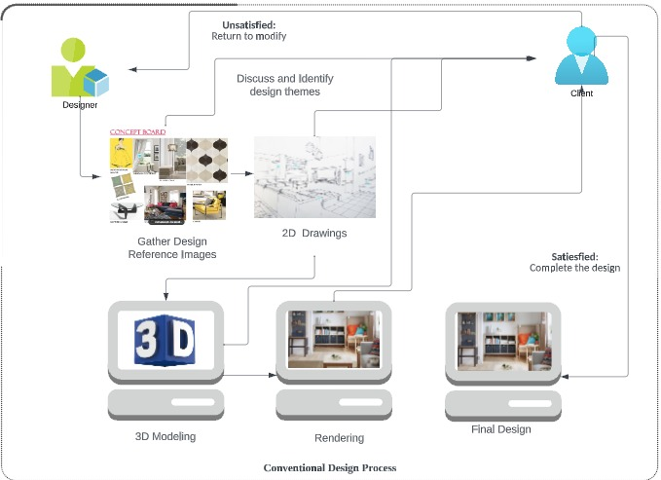
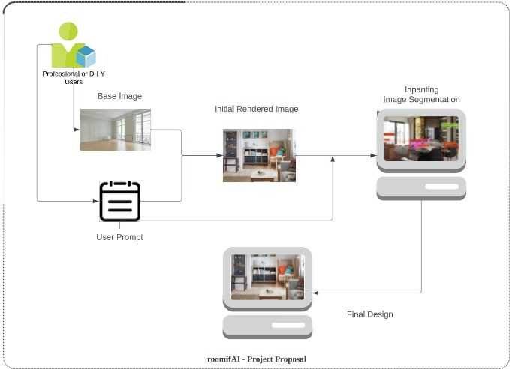
roomifAI
Project Background/Objective/Aim
Conventional methods
require a professional designer
gather reference images
produce 2D designs
3D modeling and rendering
feedback from clients
Our Solution
no expert knowledge required
textual prompts + image uploads + interactive selection
Notes:
The primary objective of this project is to provide interior design visualizations using a quick and easy method. Conventional methods of generating interior design concept drawings require a professional designer to gather reference images, produce 2D designs and 3D modeling and rendering. This process will undergo further refinement and feedback from clients, which is time consuming.
The proposed tool allows the general user to generate interior design concept art without in depth knowledge in the interior design domain, while being able to work out different design ideas through the use of textual prompts.

Slide 4
roomifAI
Project Background/Objective/Aim
Conventional methods
require a professional designer
gather reference images
produce 2D designs
3D modeling and rendering
feedback from clients
Our Solution
no expert knowledge required
textual prompts + image uploads + interactive selection
Notes:
The primary objective of this project is to provide interior design visualizations using a quick and easy method. Conventional methods of generating interior design concept drawings require a professional designer to gather reference images, produce 2D designs and 3D modeling and rendering. This process will undergo further refinement and feedback from clients, which is time consuming.
The proposed tool allows the general user to generate interior design concept art without in depth knowledge in the interior design domain, while being able to work out different design ideas through the use of textual prompts.

Slide 5
roomifAI
Project Description
Valuable for
interior designers
real estate agents or developers
Use cases
aiming to enhance visual representations for clients by presenting preliminary concepts/prototypes
market a property
For the project purpose, the tool will be used for bedrooms, living room, kitchen and bathroom, with potential development for other types of rooms.
Notes:
The tool provides potential value for interior designers, real estate agents or developers
It allows them to improve visual representations for clients by showcasing initial room design concepts or prototypes.
The tool offers foundational layouts and a range of potential designs, finishes, and furnishings to enhance visual appeal.
Initially, it will focus on bedrooms, living rooms, kitchens, and bathrooms, with the possibility of expanding to cover other types of rooms in the future.

Slide 6
roomifAI
Project Description
Valuable for
interior designers
real estate agents or developers
Use cases
aiming to enhance visual representations for clients by presenting preliminary concepts/prototypes
market a property
For the project purpose, the tool will be used for bedrooms, living room, kitchen and bathroom, with potential development for other types of rooms.

Slide 7
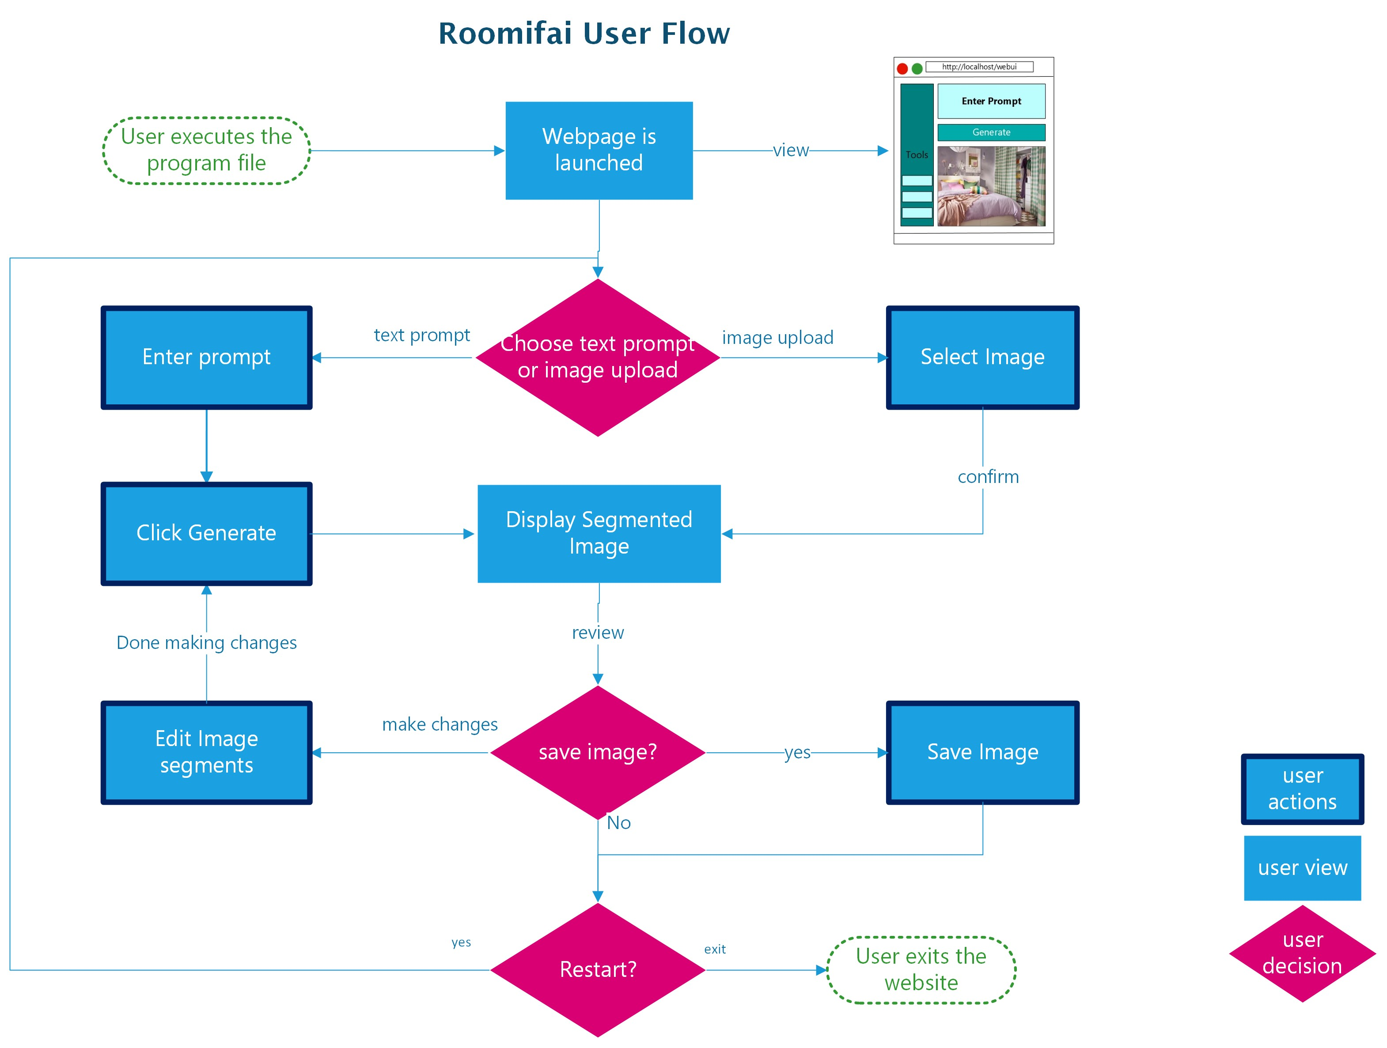
roomifAI
User Flow

Slide 8
roomifAI

Slide 9
roomifAI
User Flow

Slide 10
roomifAI
User Flow

Slide 11
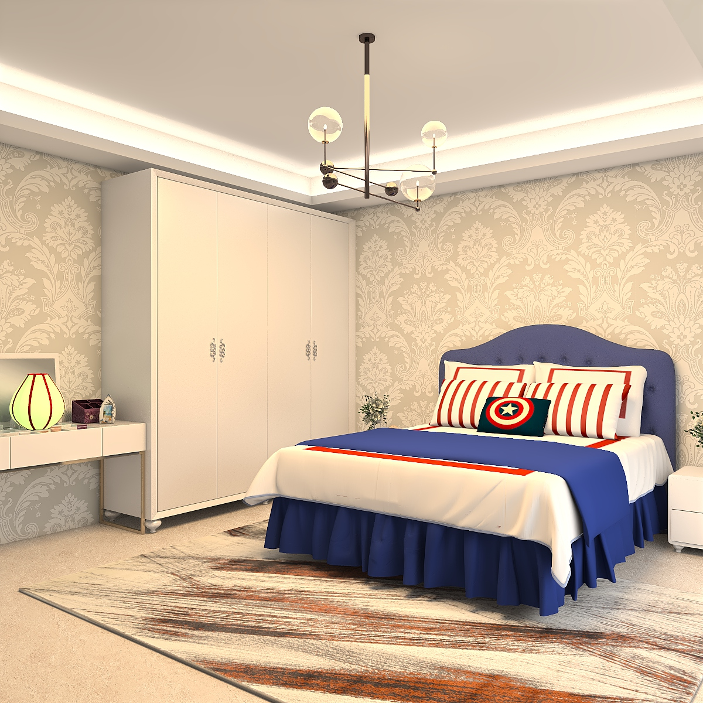
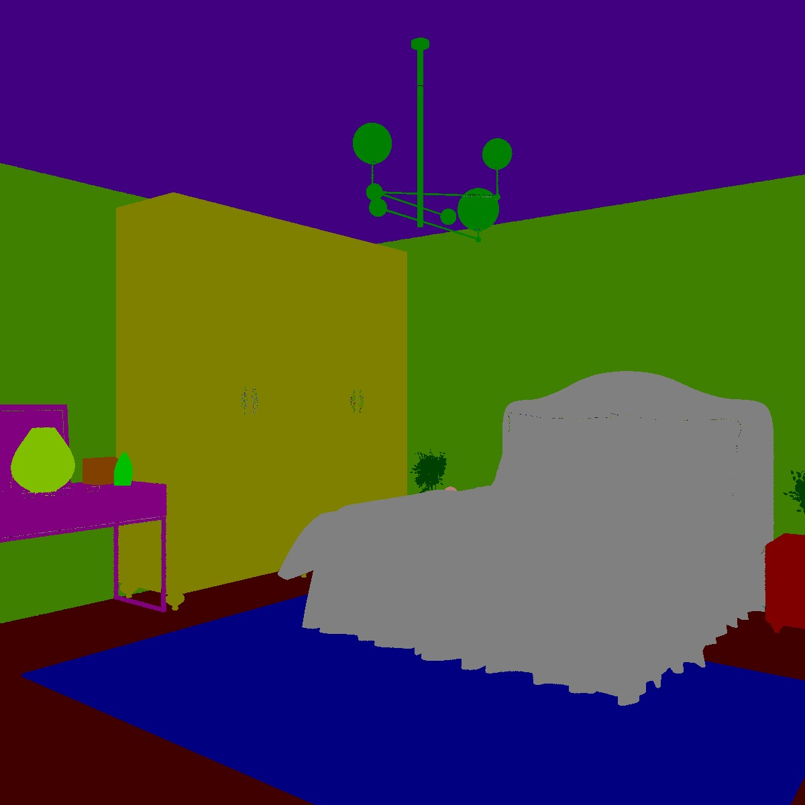
roomifAI
3D
Segmentation
Mask
2D
Data Resources
Source Name | Description | Reference
3D-FRONT | Expert designed 20,240 realistically rendered indoor 3D scenes + segmentation mask | Fu et al. (2021)
IKEA | Scraped photographs from IKEA catalogues 2,193 images of furniture's and 298 indoor scenes | Tautkute et al. (2017)
Notes:
BLIP2 Bootstrapping Language-Image Pre-training

Slide 12
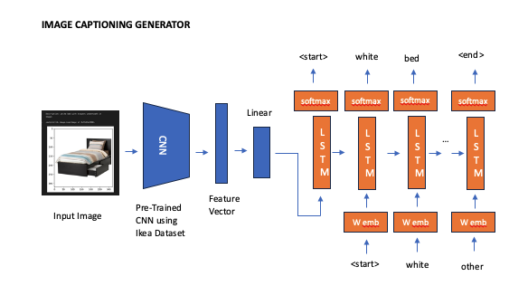
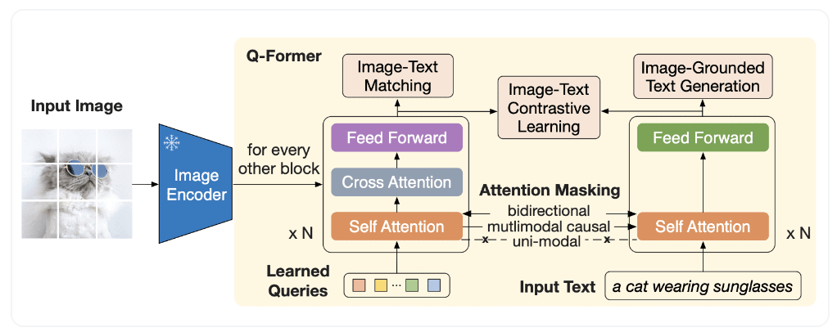
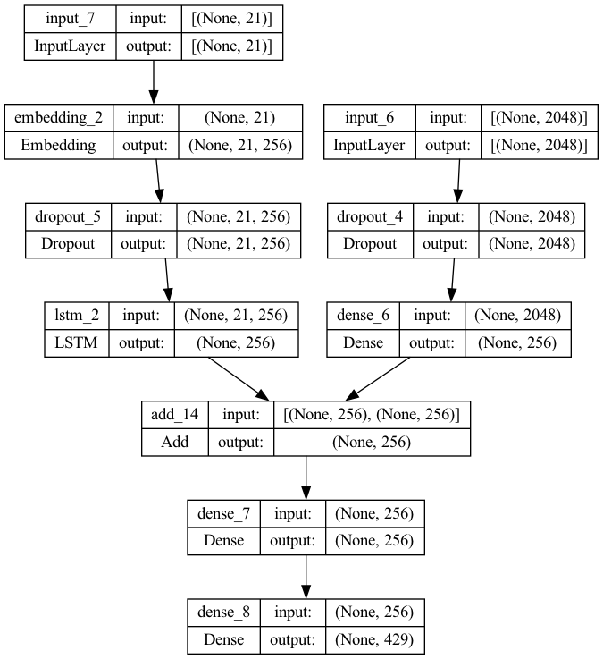
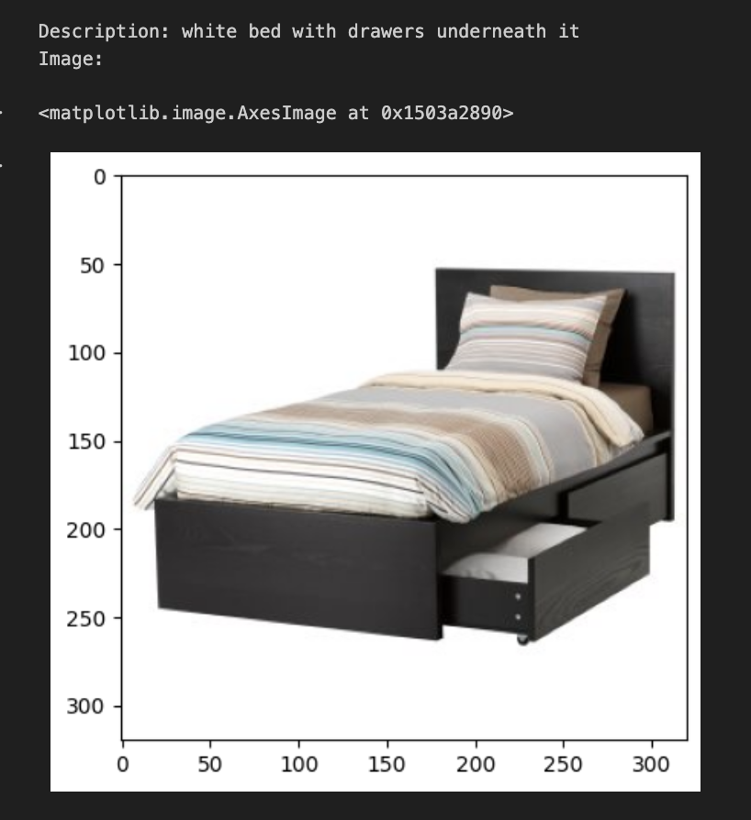
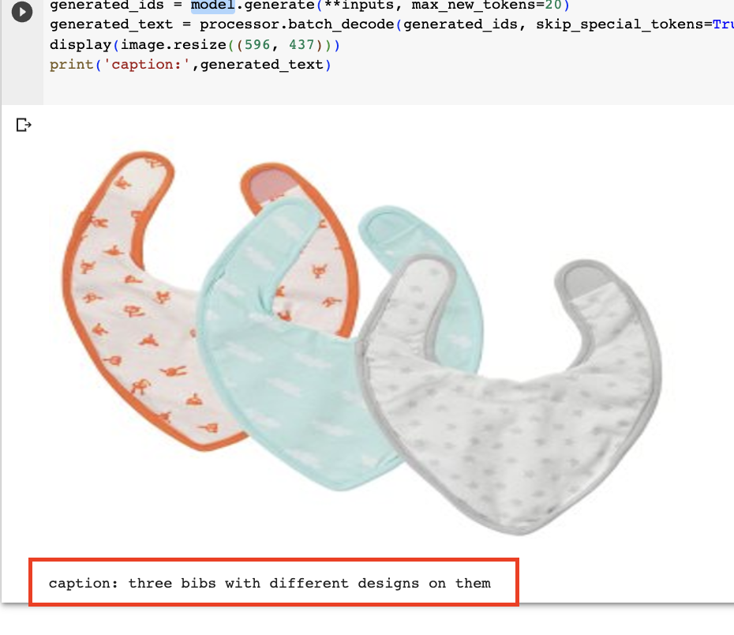
roomifAI
Image Captioning
CNN + LSTM
BLIP-2
Notes:
The team attempted to make use of CNN + LSTM hybrid network approach which consist of two components
- CNN (Convolutional Neural Network) that encodes the image into feature vectors and
- LSTM (Long Shor-Term Memory) network: that decodes the feature vector into caption or text.
the CNN finds the pattern in the image and passes them to the LSTM which outputs a word at each time step until the caption is complete.
BLIP2 Bootstrapping Language-Image Pre-Training
BLIP-2 model that addresses the gap between vision and language models. It accomplishes this by introducing a lightweight component called Querying Transformer (Q-Former) between a pre-trained image encoder and a large language model (LLM). Notably, only the Q-Former is trainable, while the image encoder and LLM remain fixed.
The image transformer in BLIP-2 extracts a fixed number of output features from the image encoder, regardless of the input image's resolution. It receives learnable query embeddings as input, which can interact with text through self-attention layers.
The pre-training of Q-Former occurs in two stages.
In the first stage, with a frozen image encoder, it is trained using three losses: Image-text contrastive loss, Image-grounded text generation, and Image-text matching loss. These losses help Q-Former understand the relationship between queries and text.
In the second stage of pre-training, query embeddings gain visual information from the image and are used as a visual prefix for the LLM. This stage involves an image-grounded text generation task using a causal LM loss.

Slide 13
roomifAI
BLIP-2
Data Resources
Source Name | Description | Reference
3D-FRONT | Expert designed 20,240 realistically rendered indoor 3D scenes + segmentation mask | Fu et al. (2021)
IKEA | Scraped photographs from IKEA catalogues 2,193 images of furniture's and 298 indoor scenes | Tautkute et al. (2017)

Slide 14
roomifAI
Data Resources
Source Name | Description | Reference
3D-FRONT | Expert designed 20,240 realistically rendered indoor 3D scenes + segmentation mask | Fu et al. (2021)
IKEA | Scraped photographs from IKEA catalogues 2,193 images of furniture's and 298 indoor scenes | Tautkute et al. (2017)

Slide 15
roomifAI
Dreambooth
LoRa
Baseline
Fine-tuning Model
Technique and tools used
Image Generation
Stable Diffusion v1.5 - diffusion-based image generation model through fine-tuned with DreamBooth and LoRA
Furniture and room layout images from a selected brand, i.e. IKEA, for fine-tuning.
Segmentation
Stable Diffusion inpainting
SegFormer, a transformer-based image segmentation model
Notes:
Central to the project's goals is to leverage Stable Diffusion v1.5, a diffusion-based image generation model through textual prompt inputs, which will be adeptly fine-tuned through the utilization of existing technologies such as DreamBooth and LoRA (Low Rank Adaptation). Furniture and room layout images from a selected brand, i.e. IKEA, will be used for fine-tuning of the model.
To allow users to easily select elements in the room to further apply Stable Diffusion inpainting, we will use SegFormer, a transformer-based image segmentation model. The model will be fine-tuned with our own labeled dataset, similar to the Stable Diffusion model above.

Slide 16
Techniques - Image Generation
Model | Description | Reference
Stable diffusion | Latent text-to-image diffusion model Use checkpoint from trained on laion-aesthetics v2 5+ dataset Finetune with Dreambooth + LoRA | Rombach et al. (2022)
Wuerstchen | Latent text-to-image diffusion model with strong compression rate Finetune from checkpoint | Pernias et al. (2023)

Slide 17
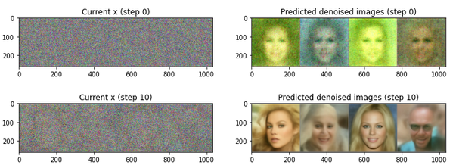
Stable Diffusion
Cuenca, P. et al. (2023). Hands-On Generative AI with Transformers and Diffusion Models. O’Reilly

Slide 18
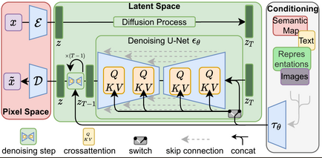
Stable Diffusion
Major components
Text encoder
Tokenization
Token embedding
Transformer
VAE
Compresses image to smaller latent space
Encoder -> latent representation
Decode -> reconstruct image
Classifier-free guidance
Match with text prompt
Predict image with text prompt conditioning and without
UNet
Denoise image
Conditioned on text embeddings

Slide 19
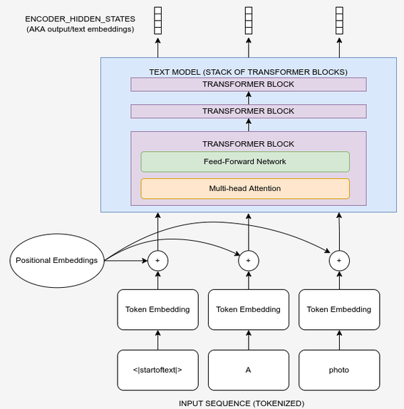
Stable Diffusion
Major components
Text encoder
Tokenization
Token embedding
Transformer
VAE
Compresses image to smaller latent space
Encoder -> latent representation
Decode -> reconstruct image
Classifier-free guidance
Match with text prompt
Predict image with text prompt conditioning and without
UNet
Denoise image
Conditioned on text embeddings

Slide 20
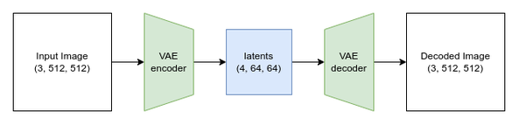
Stable Diffusion
Major components
Text encoder
Tokenization
Token embedding
Transformer
VAE
Compresses image to smaller latent space
Encoder -> latent representation
Decode -> reconstruct image
Classifier-free guidance
Match with text prompt
Predict image with text prompt conditioning and without
UNet
Denoise image
Conditioned on text embeddings

Slide 21
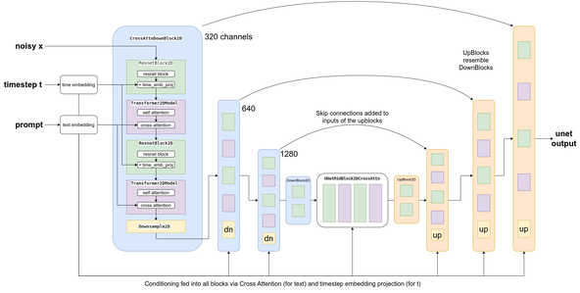
Stable Diffusion
Major components
Text encoder
Tokenization
Token embedding
Transformer
VAE
Compresses image to smaller latent space
Encoder -> latent representation
Decode -> reconstruct image
Classifier-free guidance
Match with text prompt
Predict image with text prompt conditioning and without
UNet
Denoise image
Conditioned on text embeddings

Slide 22
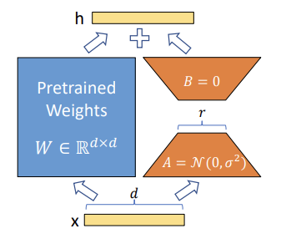
Stable Diffusion
Dreambooth and LoRA
Dreambooth
Concept: Realistic rendered rooms designed by interior designers
Training Images: Images that will be use for training the model
- the model will learn different features and characteristics within these images
- the images needs to represent what we are training the model on (different types of furniture's)
Regularization Images: Images that will be use for training not to overfit
- images needs to represent the class of the object/subject we are training the model on (a room)
LoRA
Weights in A and B will be trained
A and B weights modify weights W
Pretrained weights frozen
Different room types - bedrooms, dining, living rooms

Slide 23
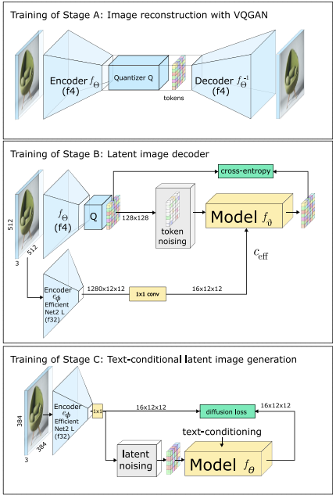
Wuerstchen
Pernias et al. (2023)

Slide 24
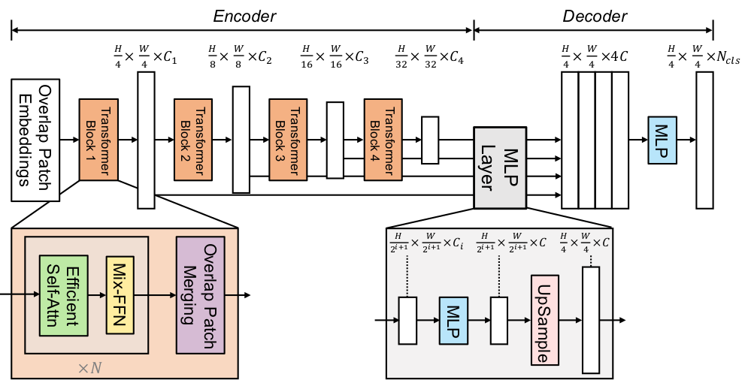
SegFormer
Xie et al. (2021) SegFormer: Simple and Efficient Design for Semantic Segmentation with Transformers

Slide 25
roomifAI
Technique and tools used
Image Generation
Stable Diffusion v1.5 - diffusion-based image generation model through fine-tuned with DreamBooth and LoRA
Furniture and room layout images from a selected brand, i.e. IKEA, for fine-tuning.
Segmentation
Stable Diffusion inpainting
SegFormer, a transformer-based image segmentation model

Slide 26
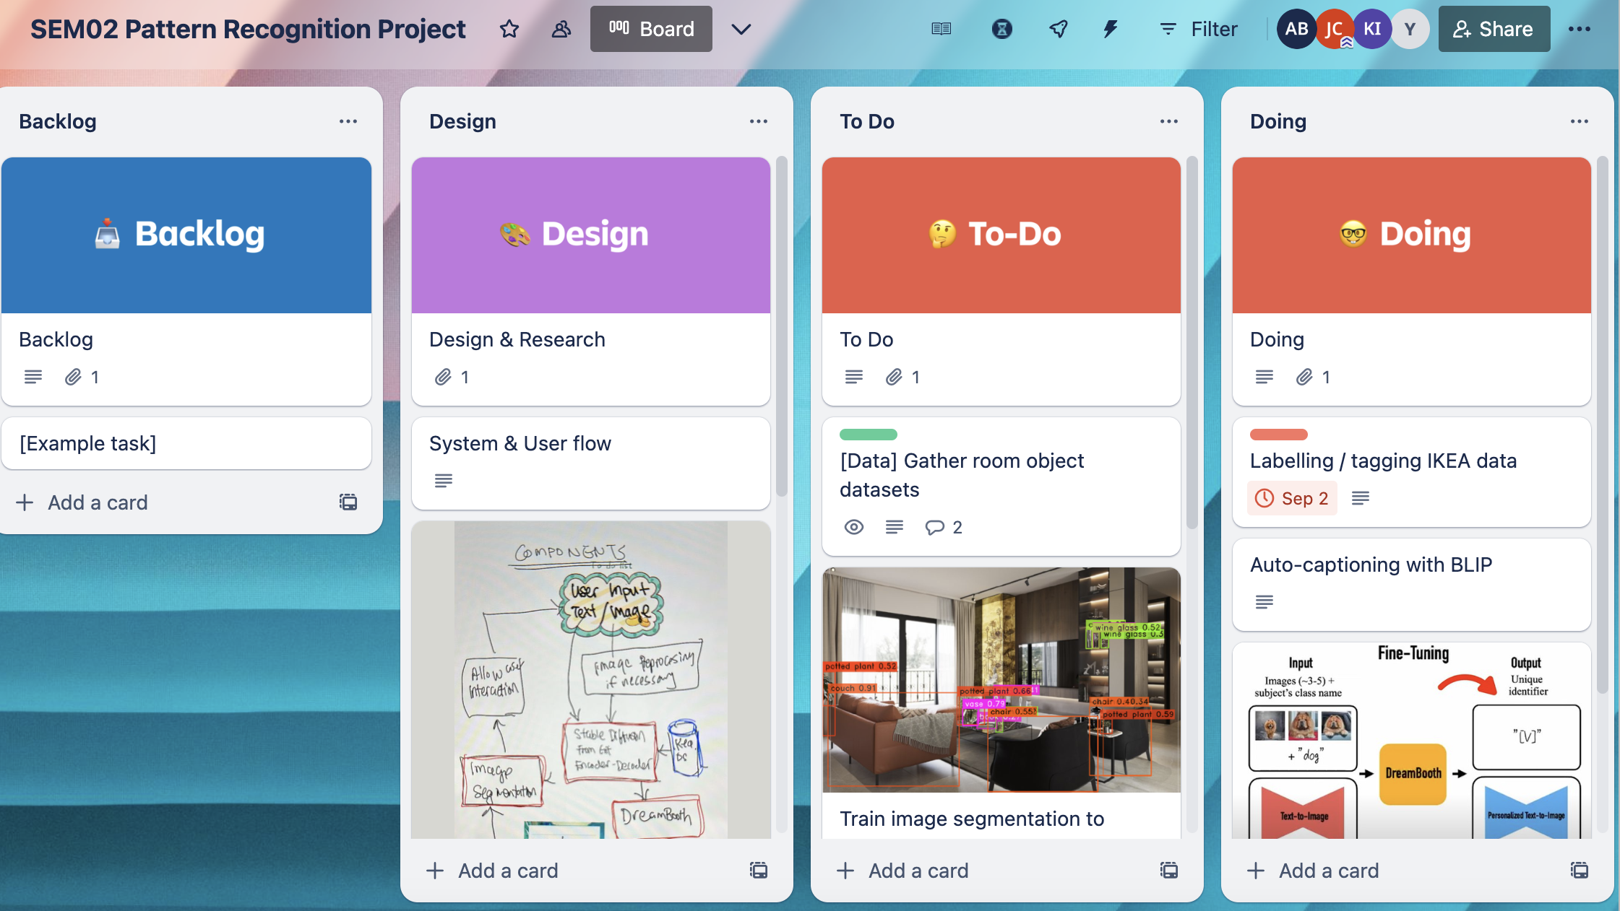
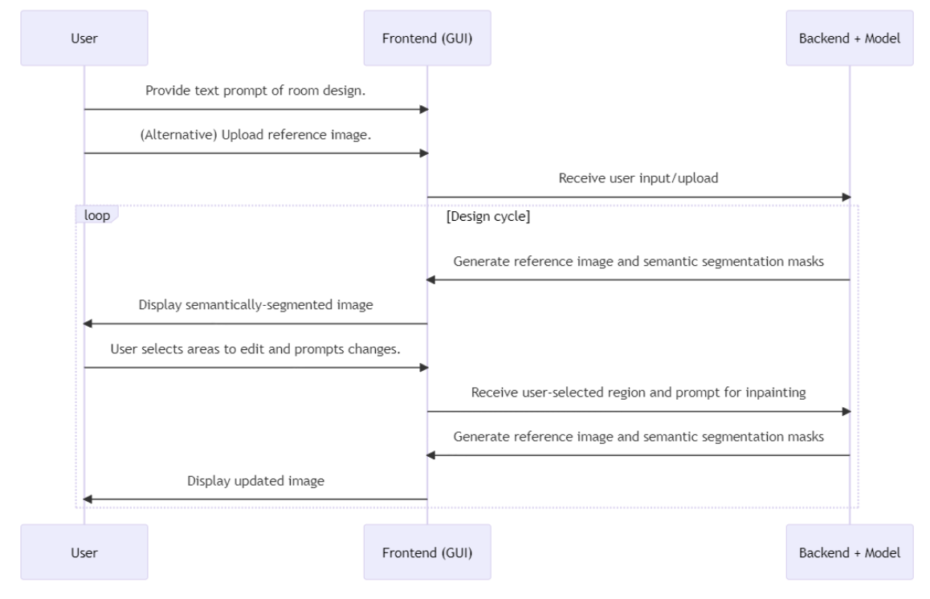
roomifAI
SEM02 Pattern Recognition Project | Trello Board
Current Progress
Completed Task
- Research and Design
- Dataset Gathering
- Dataset Processing/Tagging (2D)
Ongoing Task
- Dataset Processing/Tagging (3D)
- Testing Stable Diffusion
- Fine Tuning Stable Diffusion (Dreamboot/Lora)
- Testing Image Segmentation
- Creating UI
- Application Testing

Slide 27
roomifAI
Current Progress
Completed Task
- Research and Design
- Dataset Gathering
- Dataset Processing/Tagging
Ongoing Task
- Dataset Processing/Tagging (3D)
- Testing Stable Diffusion
- Fine Tuning Stable Diffusion (Dreamboot/Lora)
- Testing Image Segmentation
- Creating UI
- Application Testing

Slide 28
Thank You !
Group 5 Members
Chua, Jack
Ivy, Kwatt
Yeoh, Wee Chye
Borromeo, Angelie

